Slide 1

Predict house prices based on multiple properties
Yang Yuan
Xiaoyang Wang

Slide 2
CONTENTS
01
Introduction
02
Preliminary Data Processing
Import Data
Data Cleaning
Feature Engineering
03
Prediction with Four Models
Linear Regression
Support Vector Machine(SVM)
Linear Discriminant Analysis(LDA)
Quadratic Discriminant Analysis(QDA)
04
Conclusion

Slide 3

01
PART
Introduction

Slide 4

Introduction
Volume
Velocity
Variety

Slide 5
02
PART
Preliminary
Data Processing

Slide 6
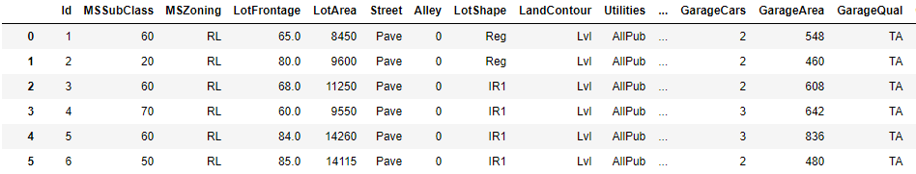

Preliminary Data Processing
Preliminary Data Processing
Import Data
Data Cleaning
Feature Engineering
Import Data

Slide 7
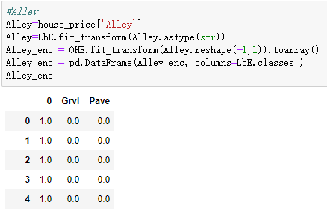
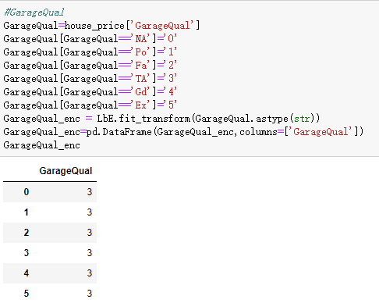
Preliminary Data Processing
Preliminary Data Processing
Import Data
Data Cleaning
Feature Engineering
Feature Engineering

Slide 8
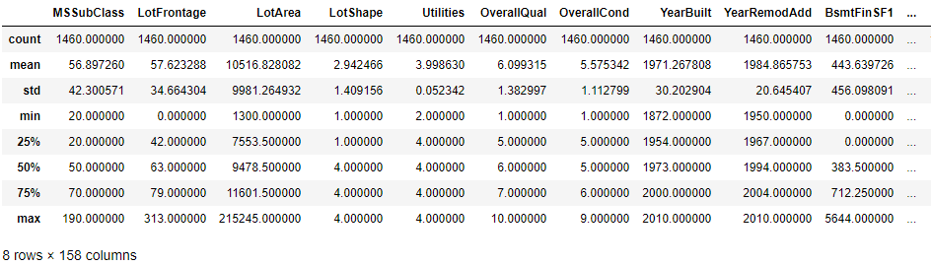
Preliminary Data Processing
Preliminary Data Processing
Import Data
Data Cleaning
Feature Engineering
Data Cleaning

Slide 9
03
PART
Prediction
With
Four Models

Slide 10

Prediction with Four Models
Linear Regression
The Result
Directly Prediction
After Parameter Tuning
10-fold cross validation
Ridge C : [0.01,0.1,1,10,100]
1 is the best
Accuracy: 76.12%
Accuracy: 81.83%

Slide 11
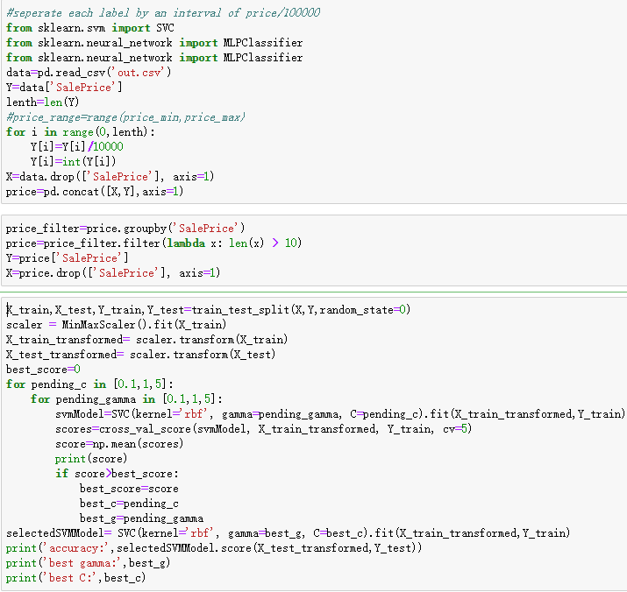
Prediction with Four Models
Support Vector Machine(SVM)
The Result
Prediction:
Accuracy: 20.86%

Slide 12
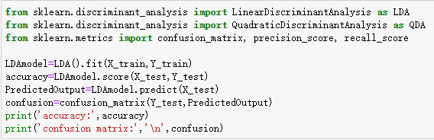
Prediction with Four Models
Linear Discriminant Analysis(LDA)
The Result
Prediction:
Accuracy: 18.12%

Slide 13
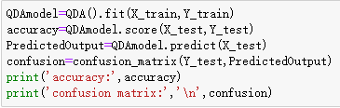
Prediction with Four Models
Quadratic Discriminant Analysis(QDA)
The Result
Prediction:
Accuracy: 8.48%

Slide 14
04
PART
Conclusion

Slide 15
Conclusion
A deeper understanding of Data analytics.
These four models: Linear Regression, SVM, LDA & QDA .
It is necessary to clean the data from many aspects.
Proper parameter tuning is a great improvement for predictive results.
Continuing to learn the relevant knowledge → Better benefit humanity.
Our teamwork ability has been improved.

Slide 16
The End
Thanks!

